Slide 1

cut1
Progression Canvas

Slide 2
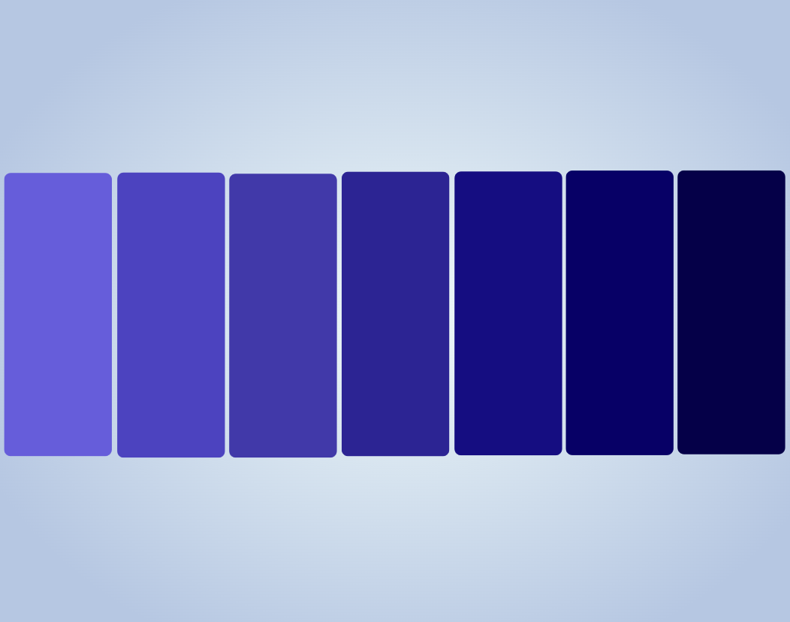


cut1
cut2
box1
box2
box3
box4
box5
box6
box7

Slide 3

cut1
cut2r
box1
box2
box3
box4
box5
box6
box7

Slide 4


